Slide 1




Craft a Story from a Dataset Applying the Storytelling Skills
Presented by: Marwan Ali
Mentor: Tony Paek
Notes:
A quick welcoming message to the leadership.
A quick introduction about the Presenter and the business problem

Slide 2

Report Purpose
Analysis Tools
01
03
Methodology
Performance results
02
04
Contents of the Report
Reduce fraud (make it at the minimum) to maintain a healthy cashflow position
SMOTE & XGBOOST
Precision-recall and Receiver operating characteristic
Forecasted business annual cost
Forecasted Vs previous results comparison and savings amount.
Research design
Data Source
Data manipulation
Analytic goals and methods
Notes:
Start by identifying the problem and the way we are handling it through the modeling process.
General overview of the methodology and the analysis tools.
A brief introduction about what we are aiming for by following this process and how we are going to make comparisons later.

Slide 3

Report Purpose
Reduce fraud
Healthy cashflow
Streamline customer experience
Increase brand trust and enhance reputation
Separate fraudulent transactions from those that are legitimate by training different models to do so.
Minimize online scams and reduce credit card skimming
Notes:
This report aims to reduce fraud and make it at the minimum to maintain a healthy cashflow position. Ultimately, we are seeking to streamline the customer experience, minimize online scams, increase our brand trust, and enhance our reputation.
To identify and separate fraudulent transactions from those that are legitimate without affecting customer experience, reduce credit card skimming, and to train different models to detect fraud within more than one application are some of the immediate objectives of the report.

Slide 4
Methodology
Data Manipulation
Missing data
Sampling strategies
Research Design
Advantages of descriptive research
Disadvantages (Jha, S., Westland J. C., 2013).
Analytic Methods
Supervised statistical methods
Unsupervised statistical methods
Data Source
Alternative resource (Kaggle 2019).
Observational method
Notes:
Research Design: Because we need to describe the fraud phenomenon and its effect on the cashflow position, we are not focusing on the why part of the research problem but rather to answer the when, what, where, and how parts. Accordingly, we are designing descriptive research because we have a little to no pertinent data and we need to give it an appropriate description using quantitative techniques.
Data Source: we identified multiple sources for alternatives and then found one real anonymous matching data from a European bank that was recently added in Kaggle (an online community for data scientists), all currencies were converted from pound sterling to US dollars.
Data Manipulation: In Random Under Sampling (RUS) method, the majority class is minimized to the same number of minority class by separating most of the class instances randomly. Synthetic Minority Oversampling Technique with Edited Nearest Neighbor (SMOTEENN) is a variant of SMOTE which is basically a combination of SMOTE and Edited Nearest Neighbor (ENN).
Analytic Methods: We are focusing to fight against fraud to secure cash at one level which is fraud detection. The statistical analytical tools that we are using have two primary goals. To minimize the total cost to the company and to minimize the number of frauds given the maximum amount of investigations we could make. To achieve that, we are using a mixed of supervised and unsupervised techniques.

Slide 5
Analysis Goals
Explore features and engineering new features
Build an effective XGBoost classifier and select an optimal cutoff
Data Processing
Models Building
Sampling Techniques
Business Impact
To make sure that we are using an effective sampling approach
Estimate the business impact and potential savings
Notes:
Preprocess the dataset, briefly exploring features & engineering new features where possible.
Experiment with sampling techniques - see if these are effective.
Build the most effective XGBoost classifier.
Select an optimal cutoff for the model, as though it were being implemented as a fraud detection system.
Estimate the business impact and potential savings.

Slide 6

Analysis Tools
Synthetic minority over-sampling techniques
SMOTE
XGBoost
Extreme gradient boosting
Precision-recall
PR
ROC
Receiver operating characteristic
Notes:
Understanding SMOTE and its pre-processing procedures: before SMOTE, after SMOTE, after SMOTE and random majority under sampling, and sampling techniques performance.
XGBoost training: 7 models used using different train data sets.
Precision-recall for each model.
ROC curves for different sampling methods
Deeper XGBoost model Vs previous best model and final performance evaluation.
Cut-off experimentation and final confusion matrix

Slide 7
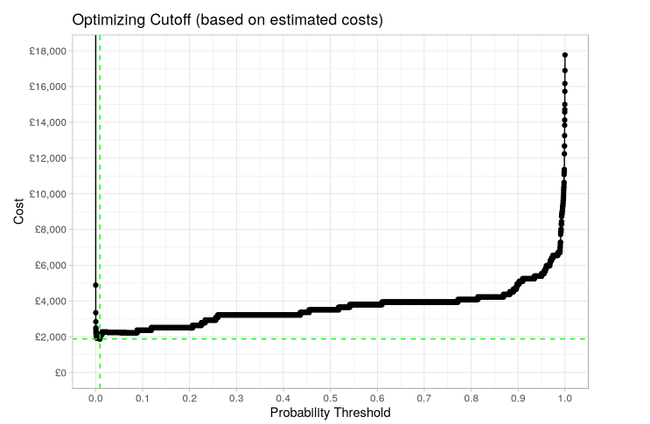
Optimizing Cutoff (based on estimated costs)
The goal is to minimize overall costs to the business, (i.e. minimize the following function): Cost = count(FP) . cost(FP) + count(FN) . cost(FN))
The selected model has found the best balance of these two errors
If you want to modify this graph, click on it, follow the link, change the data and replace it here
Notes:
Discuss the extremely low cutoff Vs extremely high cutoff (approaching 1) predictions and show why the selected model has found the best balance of these two errors.
Cost assumptions (only if being asked at any moment- + 1 min):
The amount variable is in GBP (£) and has been converted to US ($)
cost(FP) = cost of fraud refund + 3hrs investigation
cost(FN) = 20min investigation
The cost of a fraud refund is the dataset average fraud value: £122.21 or $163.94
The cost of 1hr investigation time is the average call-center hourly pay rate: £7.80 or $10.46
I therefore end up at the costs seen below:
cost(FN) = £122.21 + (£7.80 * 3)= £145.61 or $195.34
cost(FP) = £2.6 or $3.49

Slide 8
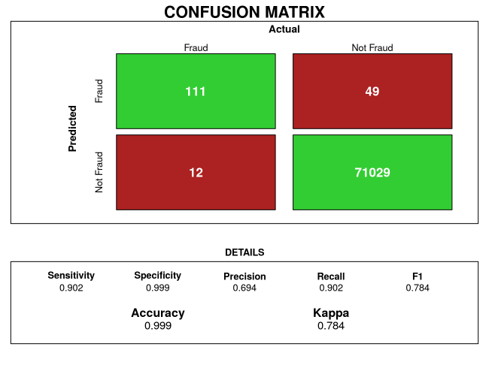
Final Confusion Matrix/ Half Day
Business values were translated to one full day in the final calculations (Clippinger, Dorinda, and Shirley Kuiper., 2016).
Notes:
The optimal balance of data and amount to up-sample/down-sample is something that will vary for different datasets.
The reason for using PR curves over ROC curves here is essentially because of the high class imbalance presented in the data.
Deeper model training and tuning.
Performance evaluation.

Slide 9
Quantifying Business Value
Full day = 246 fraud transactions
$195 per transaction
Fraud detected
No fraud detection system cost
Previous annual cost
FN & FP errors’ effects
Predicted new annual cost
$195 * 246 * 365 = $17,509,050
24 False negatives per day 98 False positives per day Business cost per day = $5,030
Annual cost = $5,030 * 365 = $1,835,950
Notes:
By substituting a realistic values to the red quadrants in the confusion matrices
Recall the assumptions from page 7

Slide 10
Fraud-handling Cost Savings
90%
$17,509,050 - $1,835,950 = $15,673,100
Notes:
Recommendations and conclusion
To get a true estimation we would want to test the models effectiveness at this cutoff on completely unseen future data sets, account for a deterioration in model effectiveness as time goes on, and take a more detailed approach to estimating costs.
Check if there are any questions (+3 min)
Thank you and enjoy the rest of your day

Slide 11

References
Clippinger, Dorinda, and Shirley Kuiper. (Ed.). (2016). Planning and Organizing Business Reports: Written, Oral, and Research-Based (1st ed.). Business Expert Press, LLC. http://ebookcentral.proquest.com/lib/ncent-ebooks/detail.action?docID=4586439
Jha, S., Westland J. C. (2013). A Descriptive Study of Credit Card Fraud Pattern. Global Business Review. https://doi.org/10.1177/0972150913494713
Kaggle (2019). Fraud Detection - SMOTE, XGBoost & Business Impact. [dataset]. https://www.kaggle.com/lmorgan95/fraud-detection-smote-xgboost-business-impact

